Slide 1
Unit VIII initial EDA of beer and brewery study
By: RENFENG WANG & VENKATA-MG-VANGA
OCT-13-2020

Slide 2
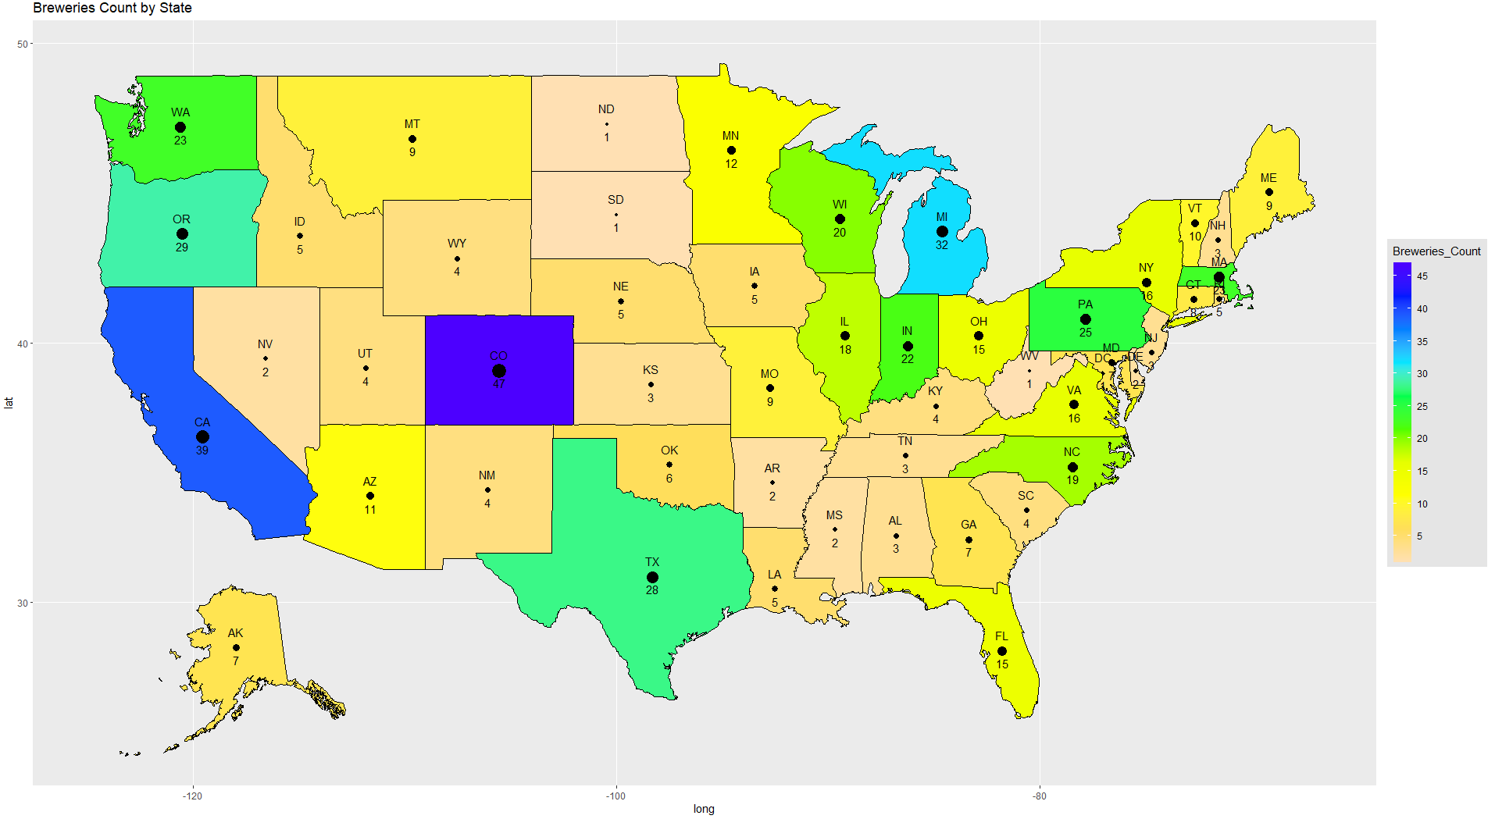
Breweries count by state
Colorado (47) has the most breweries.
California (39), Michigan (32),
Oregon (29) and Texas (28) are the next top four states with max breweries.
*Hawaii not shown on map

Slide 3
Missing Values
1005 missing values in IBU
62 missing values in ABV
As we don’t want to make up or assume any data, we decided to remove all missing values before doing further analysis.

Slide 4
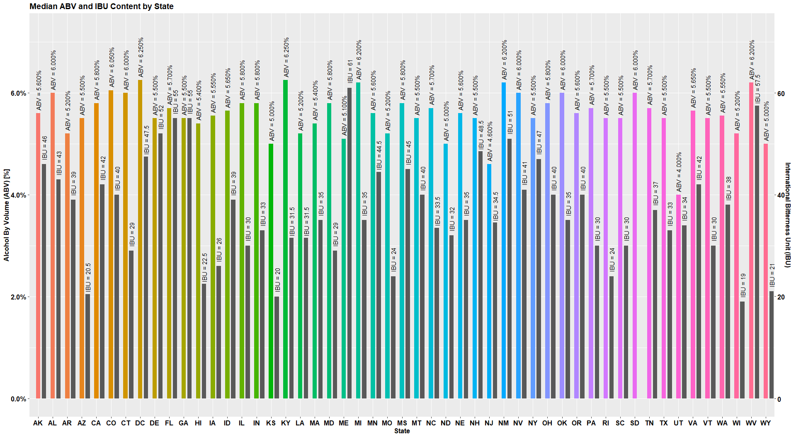
Median ABV and IBU Content by state
Washington DC and Kentucky have the highest median ABV values which are 6.25%.
Maine has the highest median IBU value 61 followed by West Virginia 57.5.
*South Dakota (SD) has no IBU values in data

Slide 5
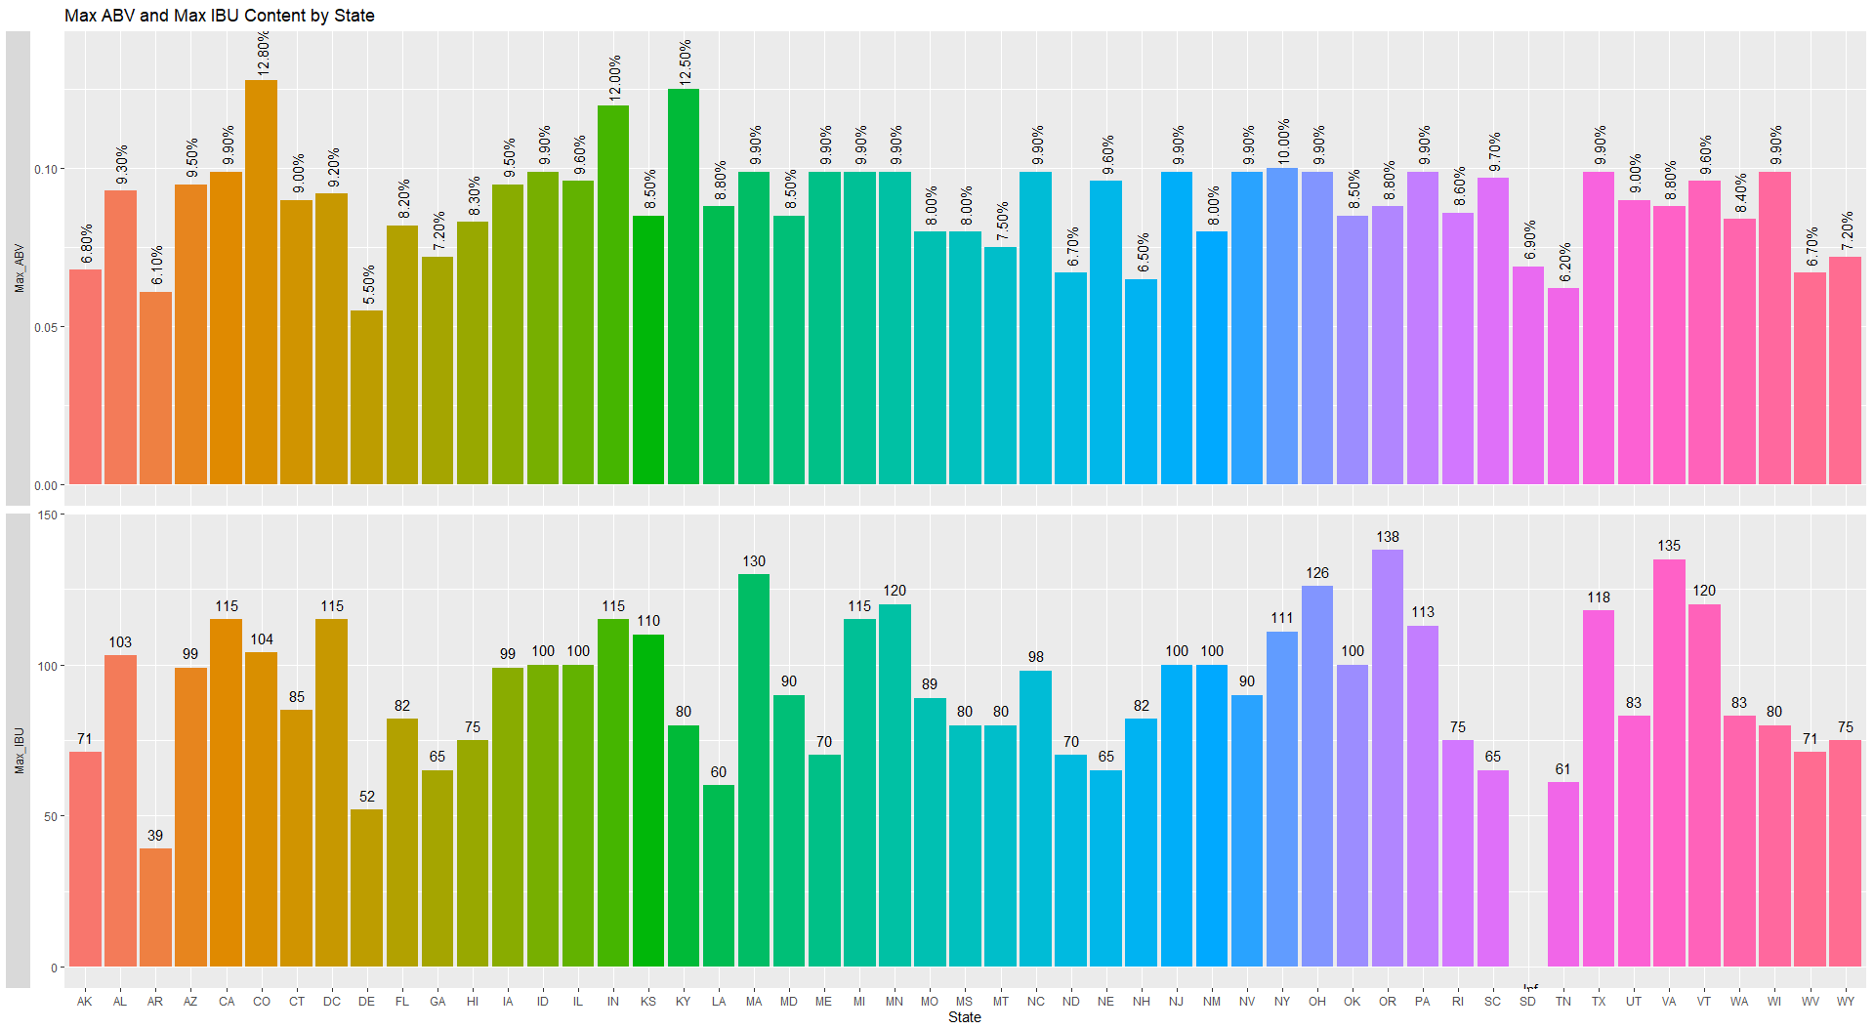
Maximum ABV and IBU by State
The State with the maximum ABV beer is Colorado (12.8%).
This is Upslope Brewing Company’s Lee Hill Series Vol.5- Belgian Style Quadrupel Ale.
The State with the maximum IBU beer is Oregon (138 IBU).
This is Astoria Brewing Company’s Bitter Bitch Imperial IPA.
*South Dakota (SD) has no IBU values in data

Slide 6
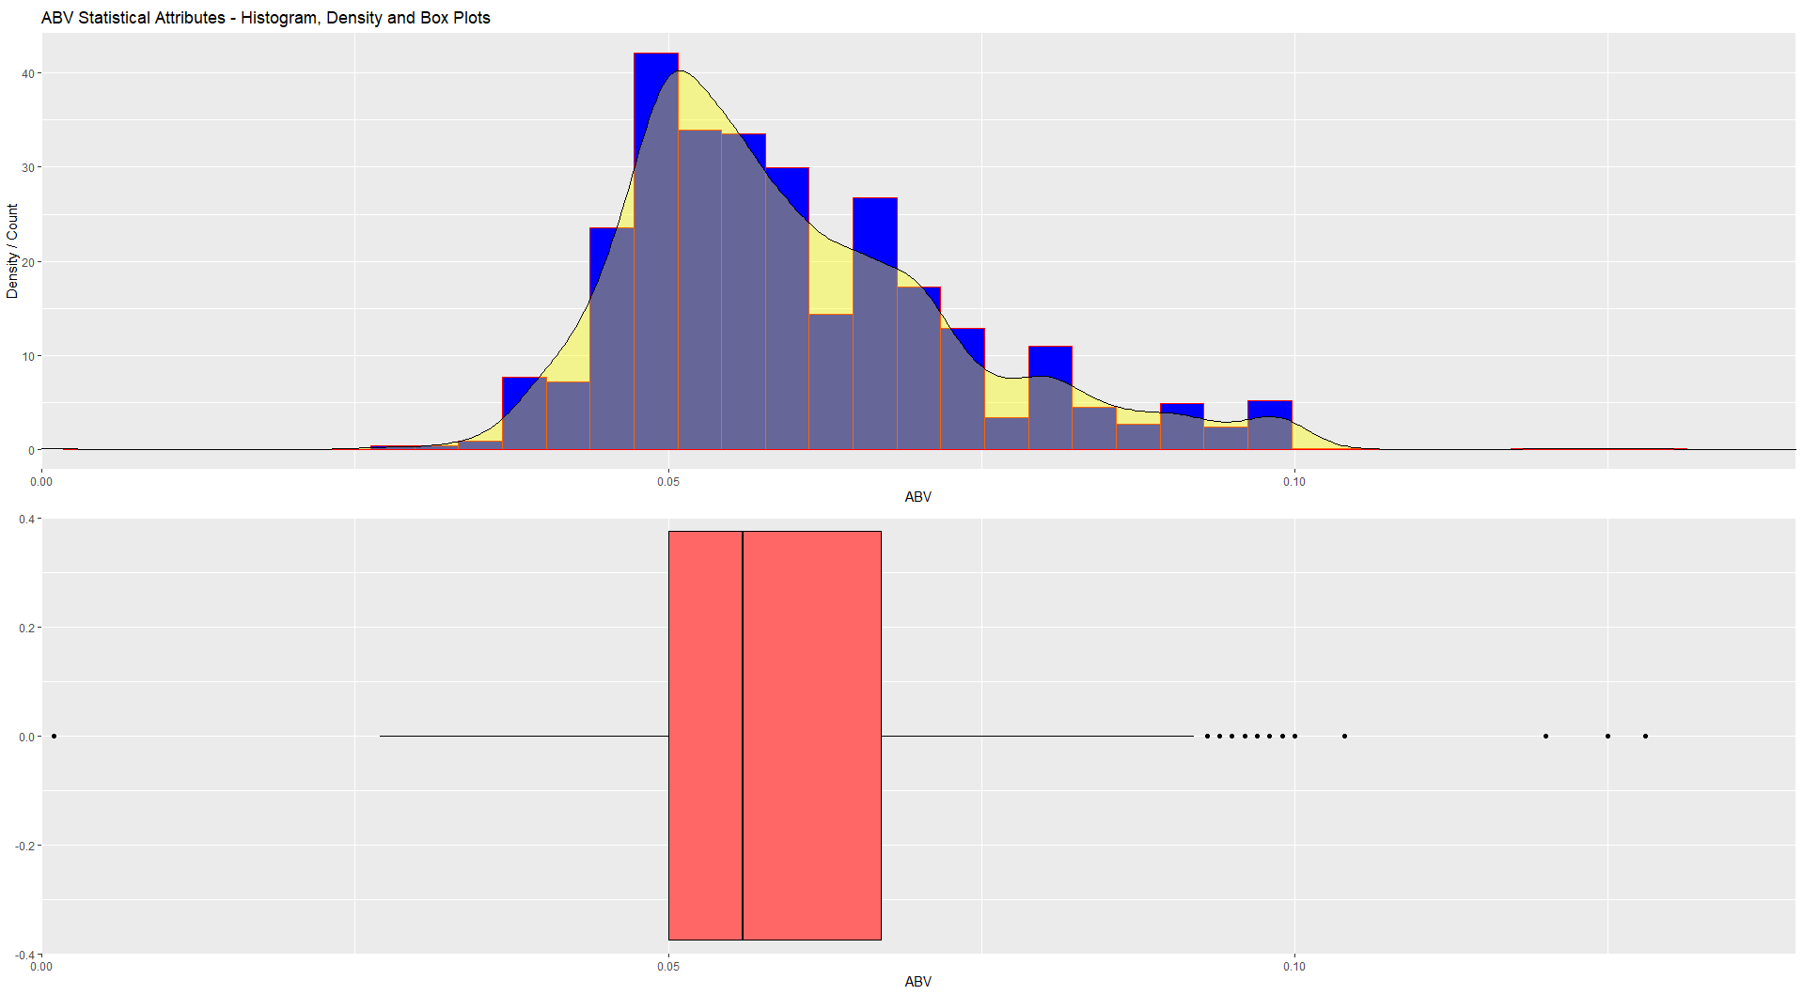
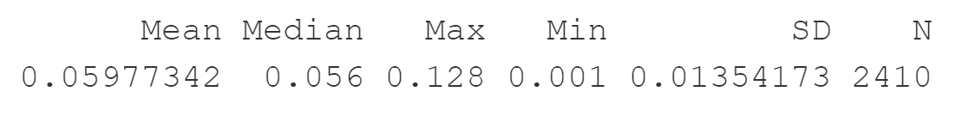
Distribution of ABV
The distribution of ABV is right skewed.
Beers with ABV around 5% has the most counts.
The maximum ABV is 12.8%.
Minimum ABV is 0.1%.
Median ABV is 5.6%.
Mean ABV is 5.98%.
Standard deviation of ABV is 1.35%.
There are total 2410 total ABV values in the data set.

Slide 7
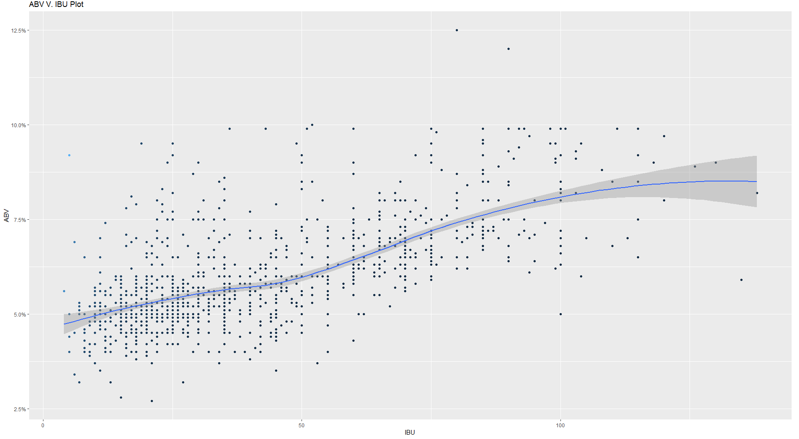
Relationship between ABV and IBU
The correlation value for IBU and ABV is 0.675 which indicates that there is a moderately positive linear relationship (i.e., as IBU increases ABV increases).
Most beers with lower IBU (less than 50) have ABV values around 5%.
When IBU value increases, ABV values spreads out. But most beers with IBU values above 50, their ABV values spread out within the region between 5% and 10%.
Local Polynomial Regression Fitting (leoss) method is used to evaluate the relationship between ABV and IBU.
It is interesting to note highest ABV value corresponds to approximately half IBU range and highest IBU value corresponds to approximately half ABV range.

Slide 8
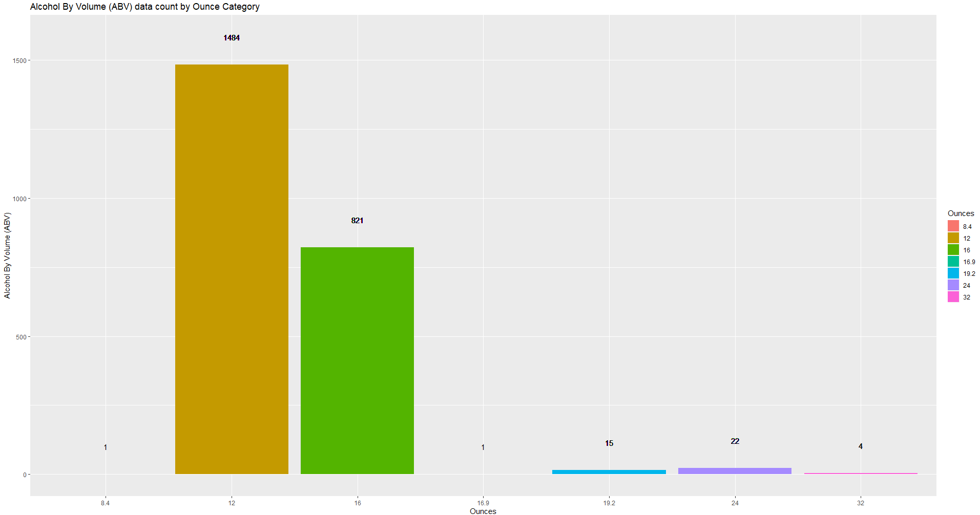
ABV categorized by ounces
There are total 2348 ABV values available as categorized above in the data set. 62 ABV values missing in the data set

Slide 9
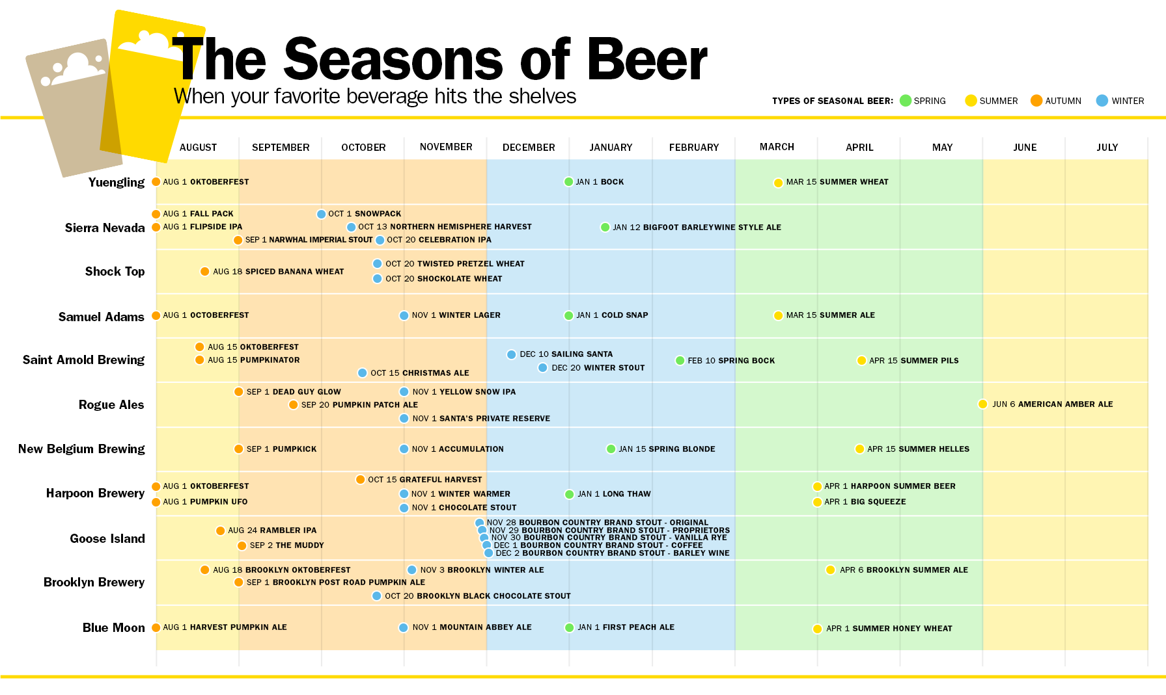
Innovation
We believe targeting to market the beer at times where the chart shows gaps would increase the market share of Budweiser.
Source: https://time.com/beer-guide/

